Slide 1
Jen Thorpe’s TEDX talk

Slide 2

P peline
The Data
Visualizing Big Data
© Jennifer Mankoff
The Data Pipeline; HCII; Spring 2014

Slide 3
Visualizing Big Data
2013 quote: 90% of the world’s data was created in just the last two years
First a tour
Then some techniques
http://www.smashingmagazine.com/2007/08/02/data-visualization-modern-approaches

Slide 4
Ben Fry

Slide 5
Ben Fry

Slide 6
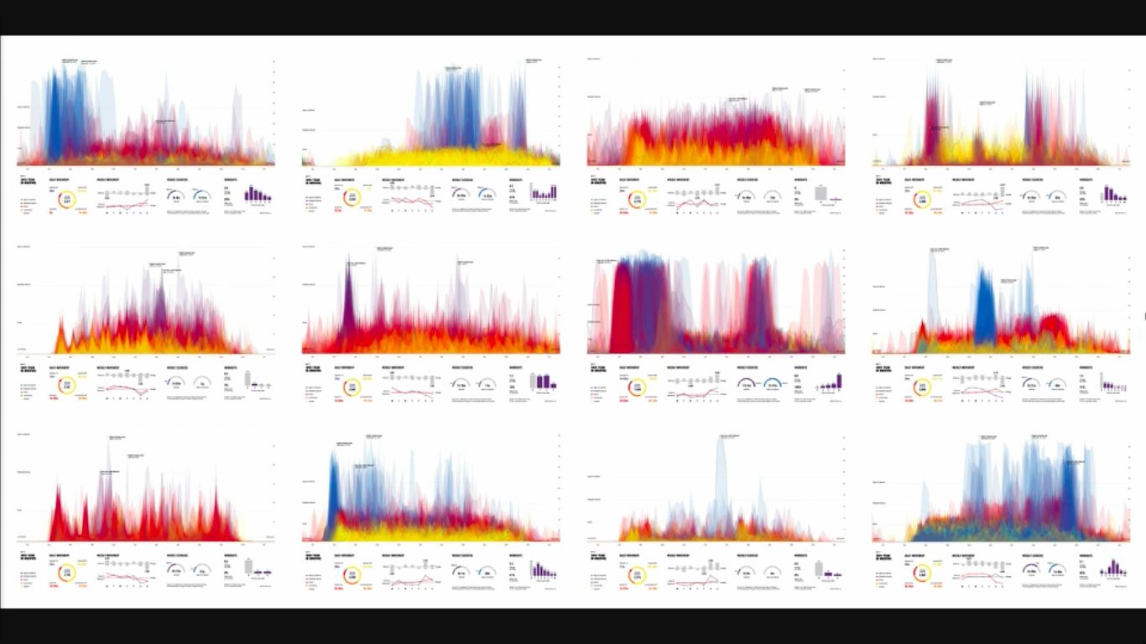
Ben Fry
https://vimeo.com/122748595
Notes:
Year of data for many different people…
https://vimeo.com/122748595
https://www.fastcodesign.com/3026292/ben-fry-makes-your-sweaty-fuelband-runs-look-gorgeous#7

Slide 7
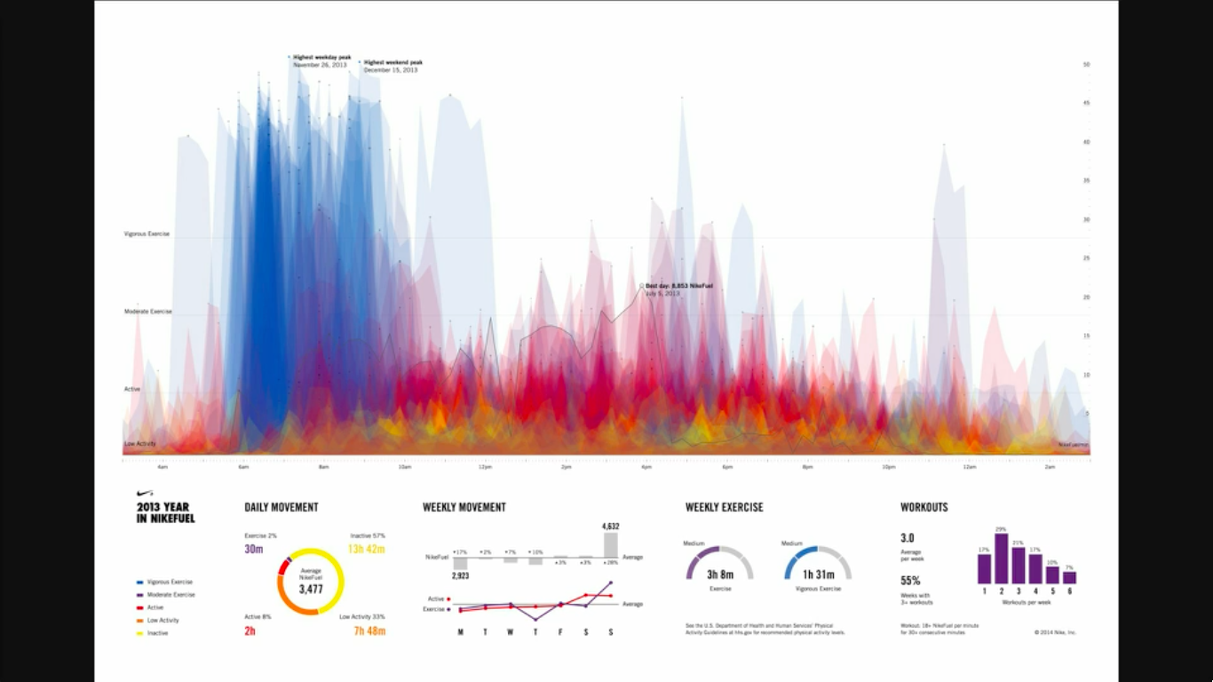
Morning Runner
Notes:
Runs in th

Slide 8
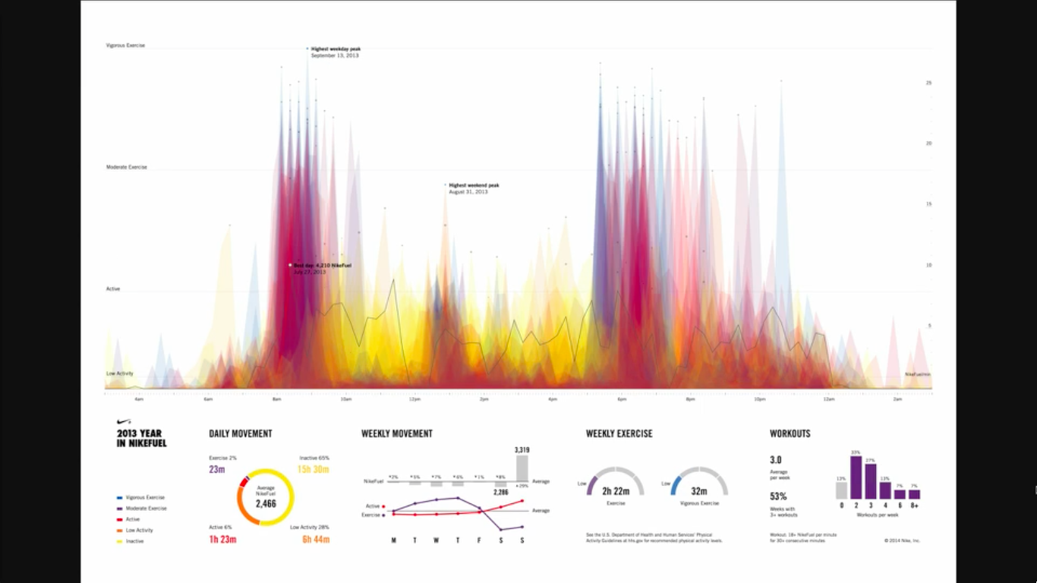
Bike commuter; lunch walker
Notes:
Runs in th

Slide 9
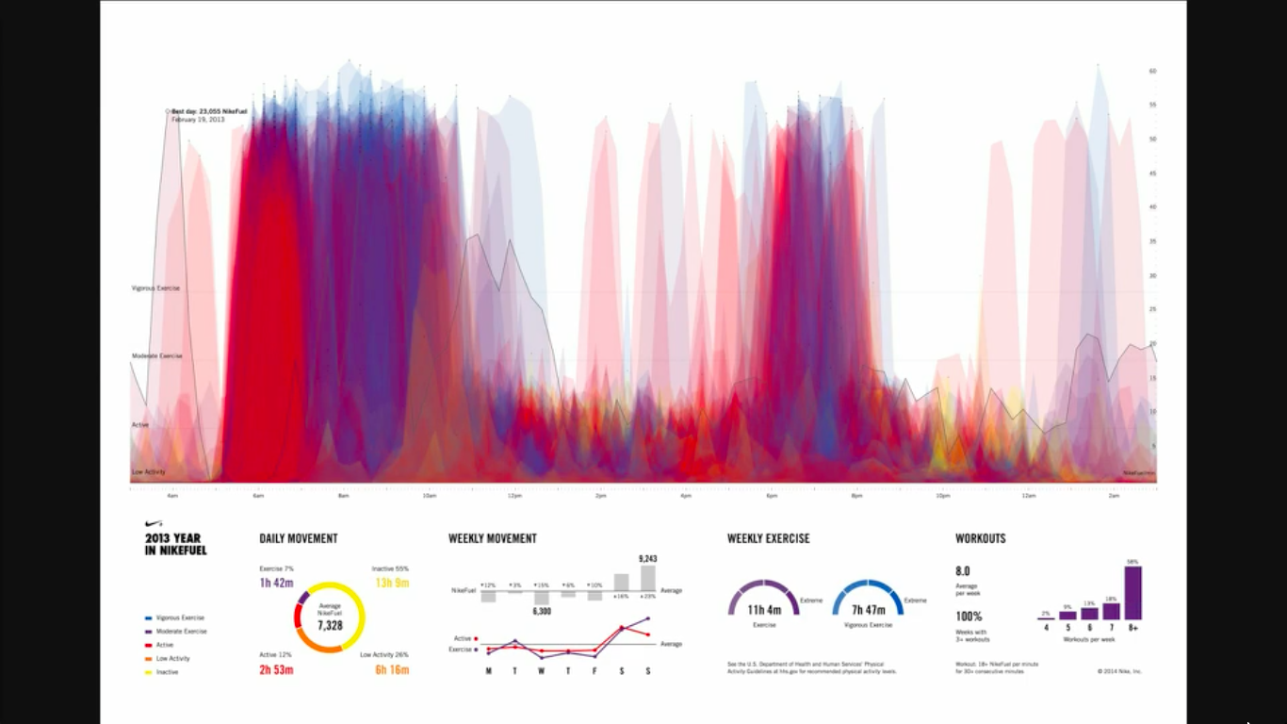
Marathon Runner

Slide 10
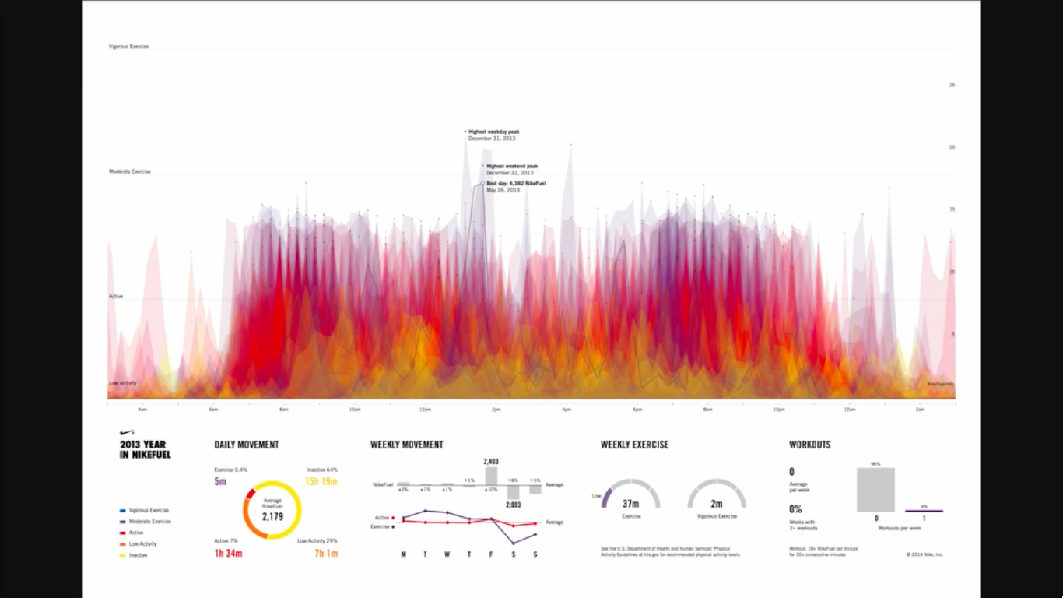
New baby at home

Slide 11
Migration
These flows represent 75% of all human movement from 2005-2010. (Circos / Krzywinski, M. et al.)
Notes:
https://qz.com/192440/where-everyone-in-the-world-is-migrating-in-one-gorgeous-chart/
It’s not the poorest who migrate the most
global migration rate has stayed roughly the same since around since 1995
the US is the largest single migrant destination

Slide 12
CLOCKWISE FROM TOP right, the genomes of a human, a chimpanzee, a mouse and a zebrafish are arranged in a circle, with each color square corresponding to a pair of chromosomes. Lines connect similar DNA sequences, visually emphasizing just how much DNA we share with other species. (Image: Martin Krzywinski/EMBO)
Notes:
https://www.wired.com/2013/11/wired-data-life-martin-krzywinski/

Slide 13
the British Library compares our genome with the genomes of 16 different species, from horse to platypus. In each panel, a circle represents the comparison between one human chromosome, its DNA arranged along the circle's bottom half, and the entire genome of a given species, located on the circle's top half. (Image: Martin Krzywinski)
Notes:
https://www.wired.com/2013/11/wired-data-life-martin-krzywinski/

Slide 14
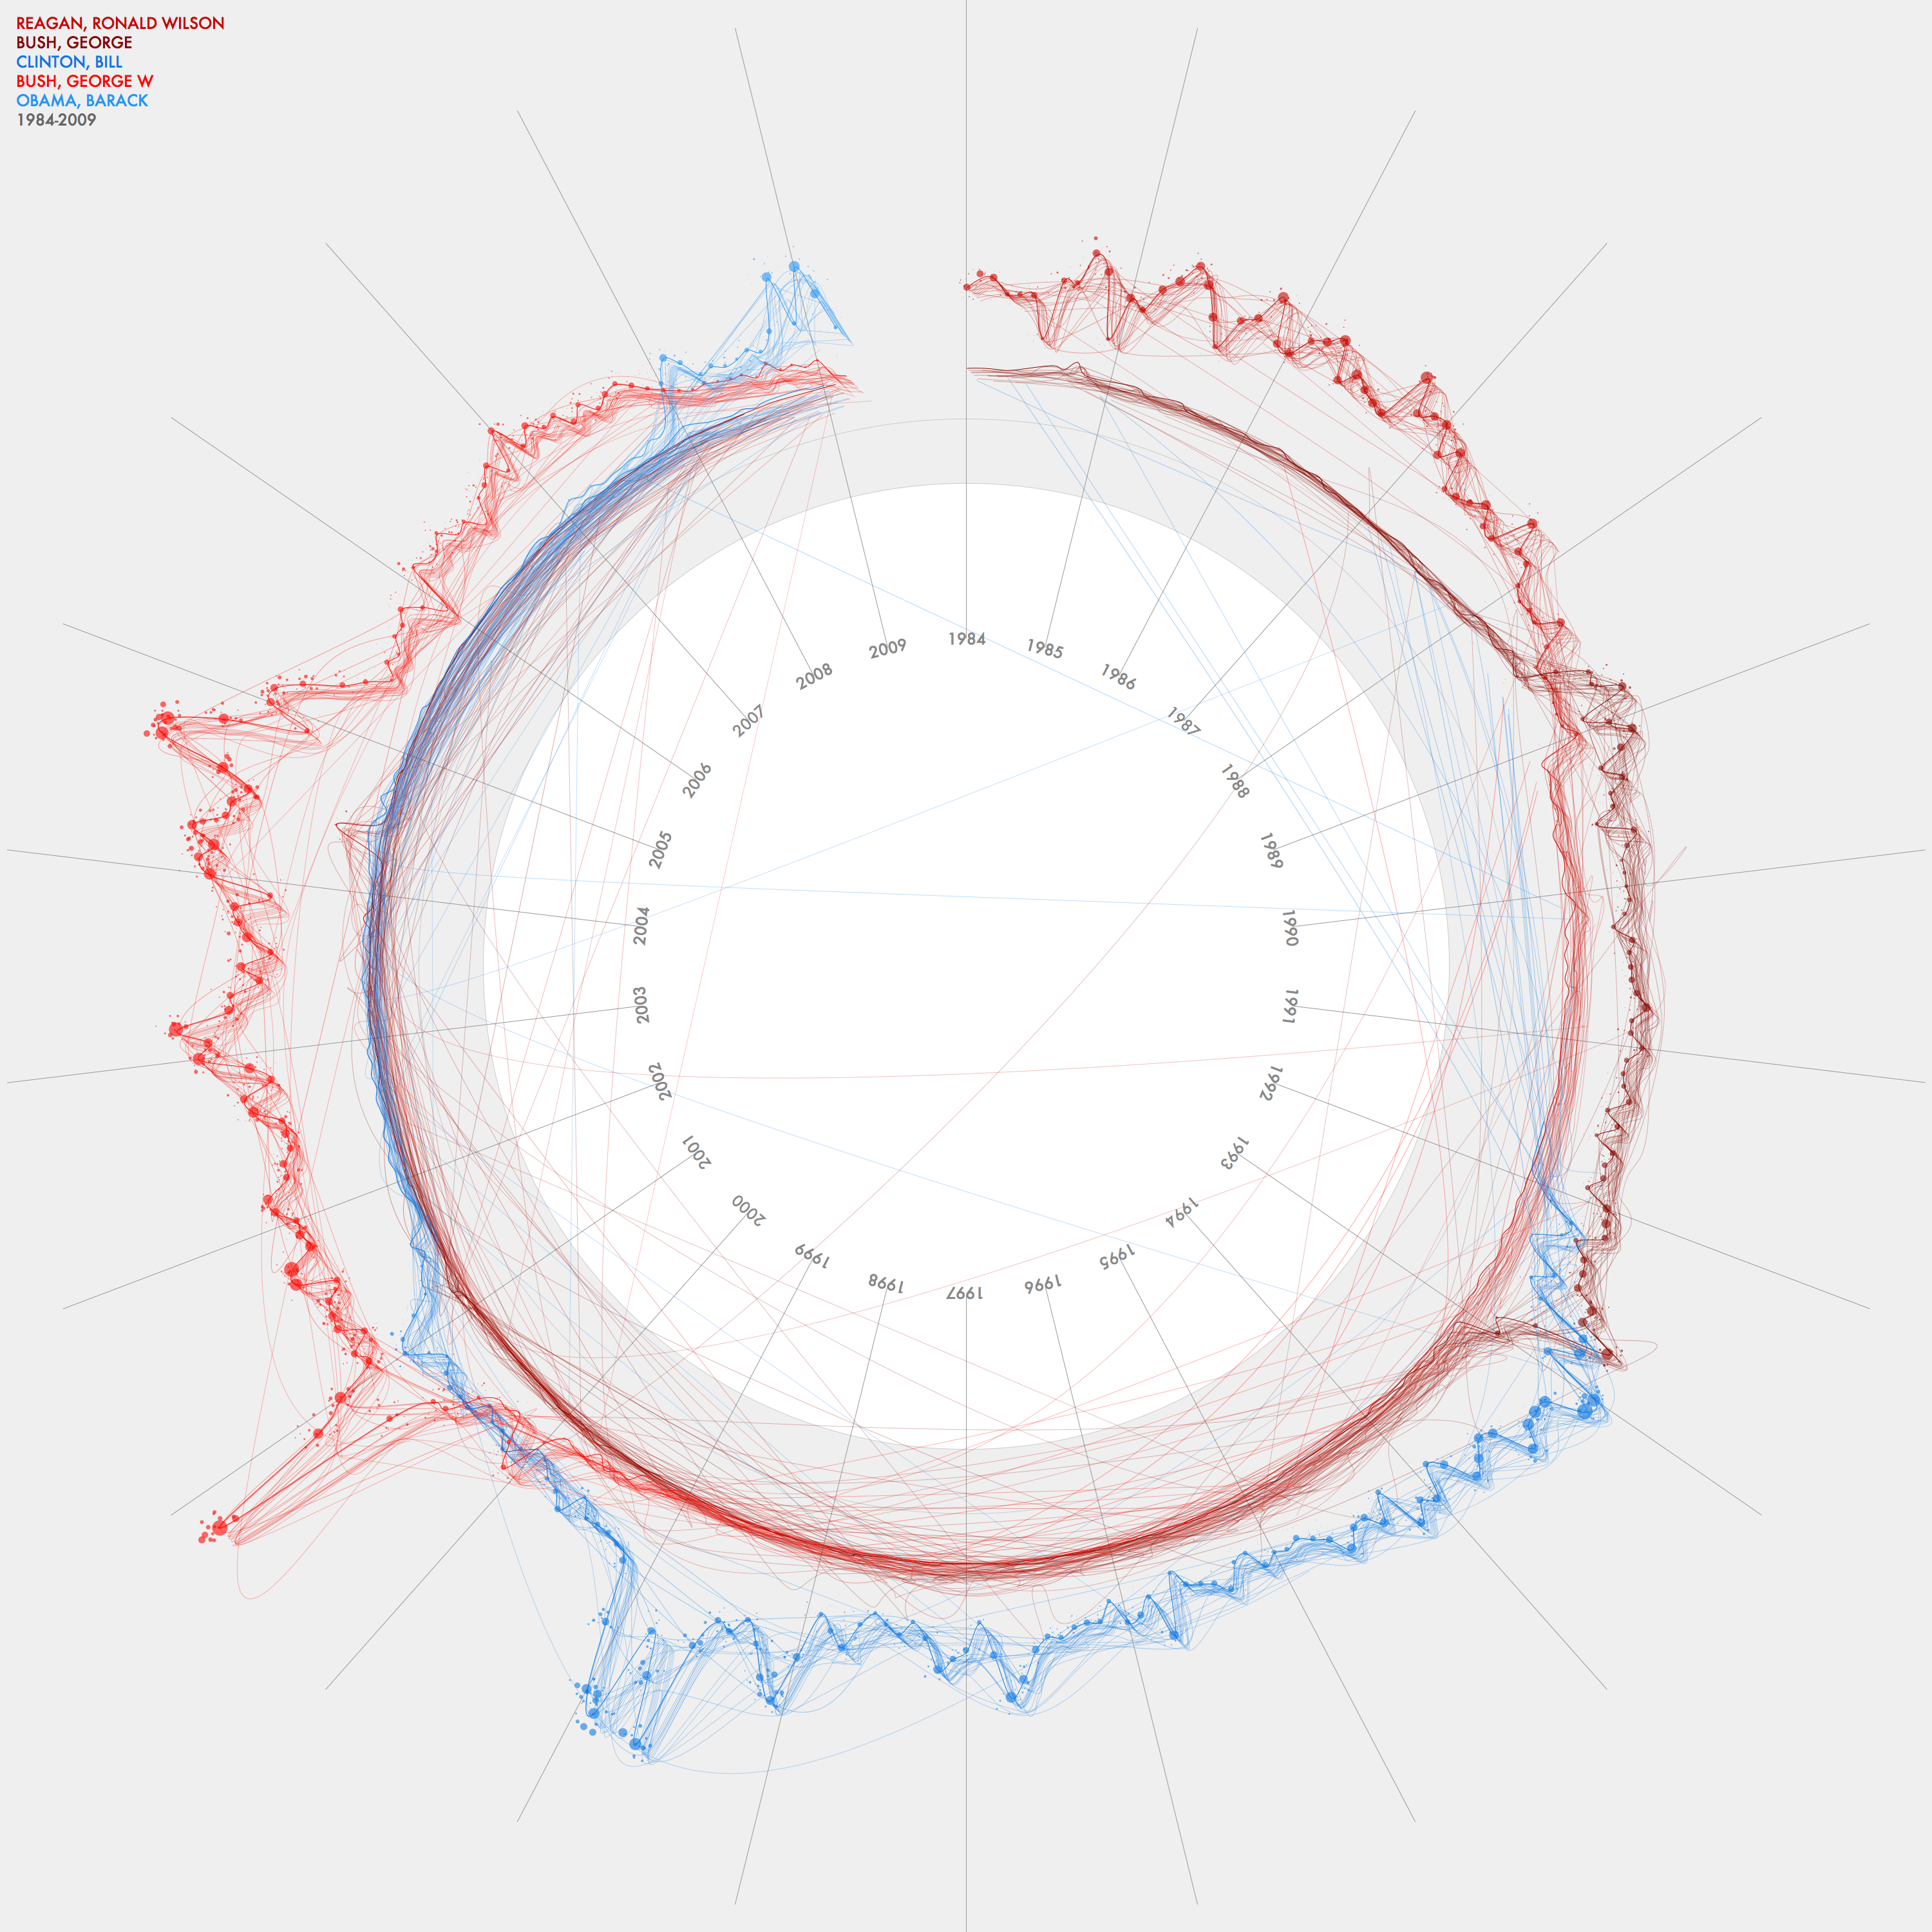
Jer Thorp
Data Artist
This graph charts the frequency of mention of the five US Presidents between 1984 and 2009. It also indicates weighting of stories - the darkest line shows front page stories while the lighter lines indicate stories buried deeper in the paper.
Built with Processing, v. 1.0
blog.blprnt.com
Notes:
http://blog.blprnt.com/selected-works

Slide 15
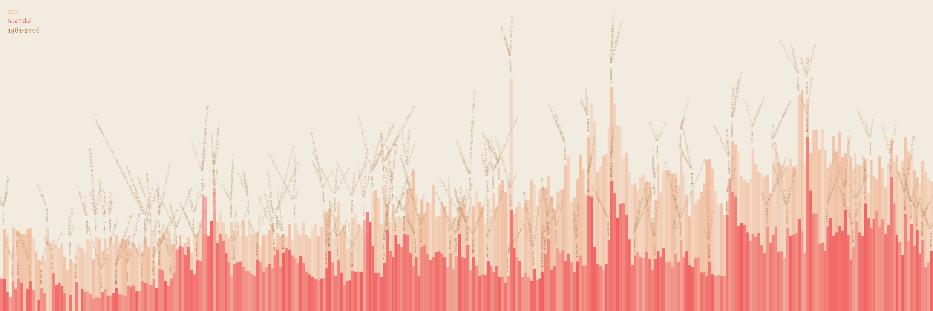
Jer Thorp
Data Artist
NYTimes: Sex & Scandal since 1981
This is a visualization of the frequency of occurrence of the words 'sex' and 'scandal' in the New York Times, since 1981.
See how many times you can count the words 'catholic church'.

Slide 16
Jer Thorp
Data Artist
NYTimes: Sex & Scandal since 1981
This is a visualization of the frequency of occurrence of the words 'sex' and 'scandal' in the New York Times, since 1981.
See how many times you can count the words 'catholic church'.

Slide 17

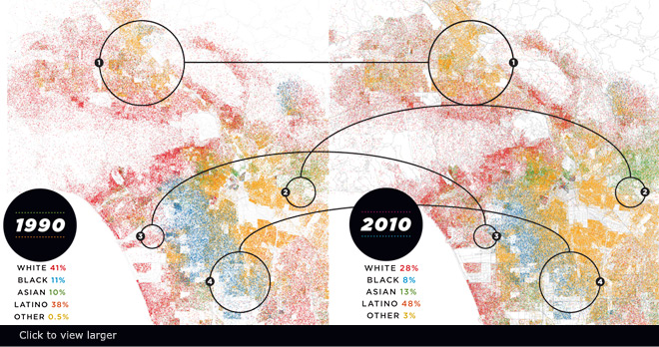
Race in LA (Eric Fischer)
Nice narrative @lamag.com http://www.lamag.com/features-hidden/race-in-la-see-how-weve-grown/#0412infographic
Notes:
1. Most highly concentrated in the north San Fernando Valley, Latinos are now the region’s largest ethnic group.
2. With 47% of its population of Chinese descent, Monterey Park is the first mainland American city to have an Asian majority.
3. An empty industrial relic in 1990, Playa Vista is now one of L.A.’s most racially and ethnically diverse communities.
4. African Americans continue to leave South L.A. Compton is now 65% Latino, though there are no Latinos on the city council.
- See more at: http://www.lamag.com/features-hidden/race-in-la-see-how-weve-grown/#0412infographic

Slide 18
World travel and communications recorded on Twitter
Green is physical movement from place to place; purple is @replies from someone in one location to someone in another; combining to white where there is both.
Reported trips to Null Island excluded; all other geotags trusted. Endpoints of trips are real data; routes in between are fabricated. Brightness is logarithmic.
Data from the Twitter streaming API through September 1, 2011. Continent shapes from Natural Earth. Author: Eric Fischer https://www.flickr.com/photos/walkingsf/6635655755/in/photostream/

Slide 19
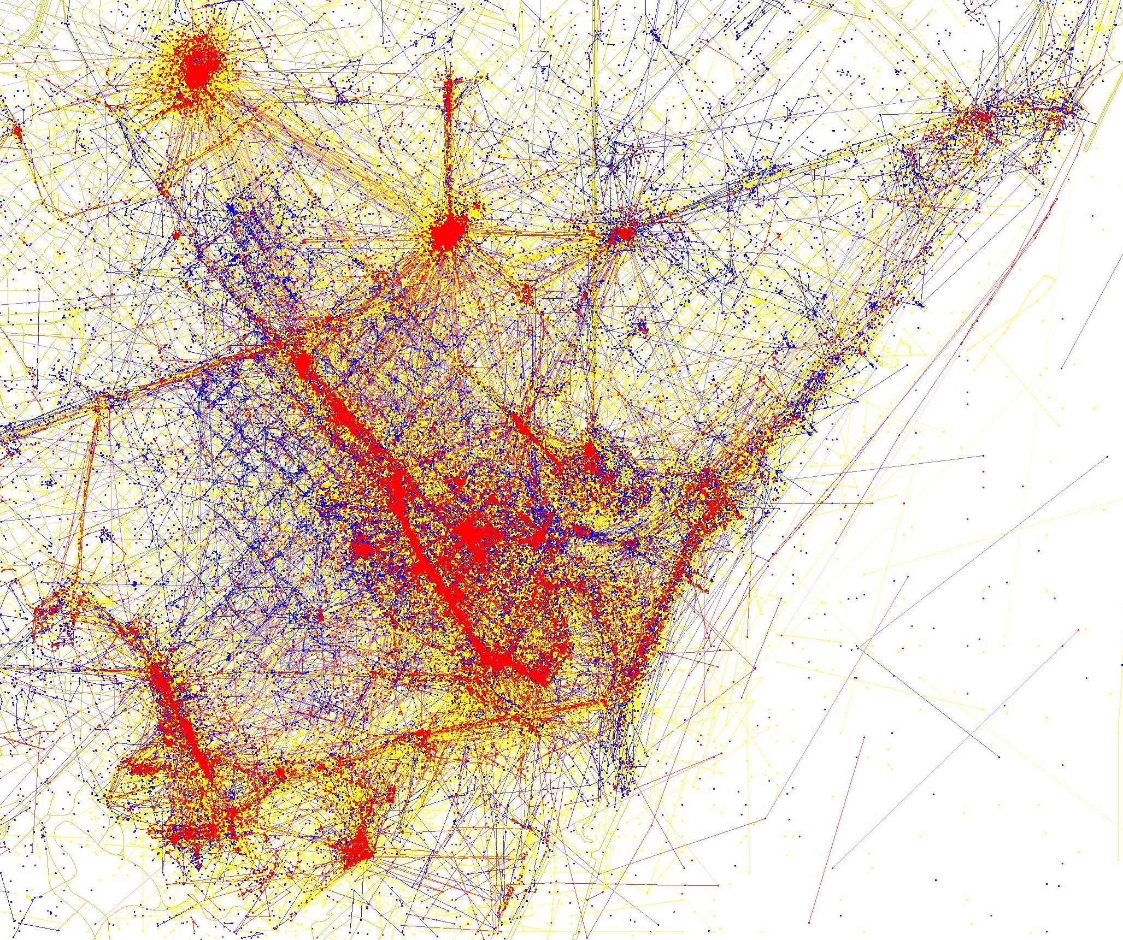
Tourist vs locals in Barcelona. Shows. Blue photos (Flickr) live in the city, red are tourists, yellow are unknown. Eric Fischer again
More details:
https://lotteharmsen.wordpress.com/tag/eric-fischer/

Slide 20
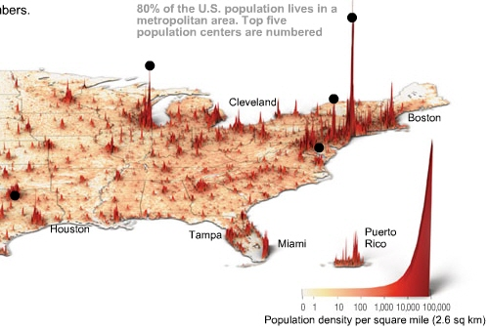
Time Magazine
http://content.time.com/time/interactive/0,31813,1549966,00.html

Slide 21
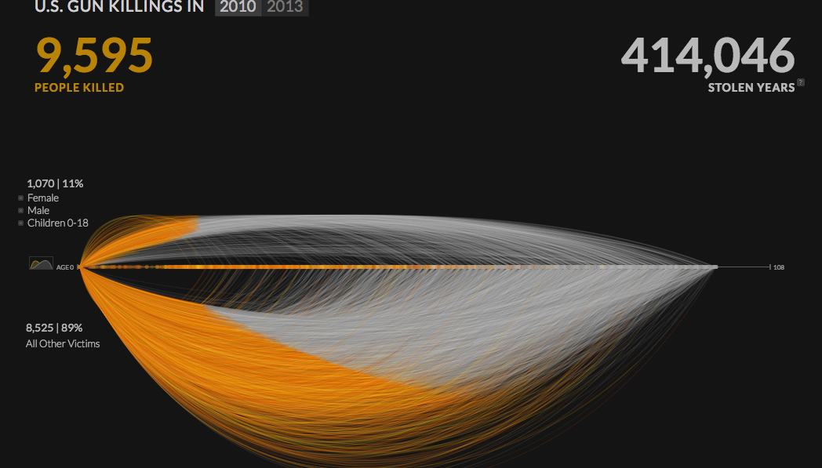
http://guns.periscopic.com/?year=2010

Slide 22
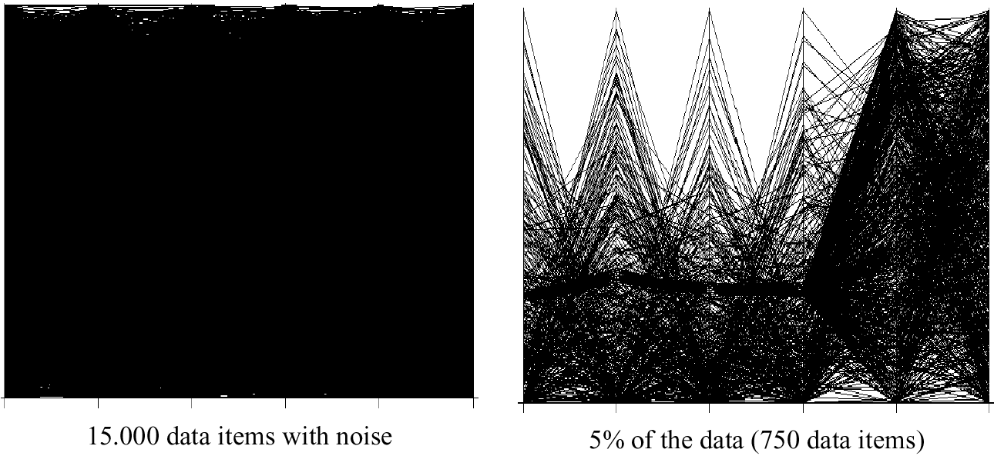
Visualization Techniques for Big Data

Slide 23
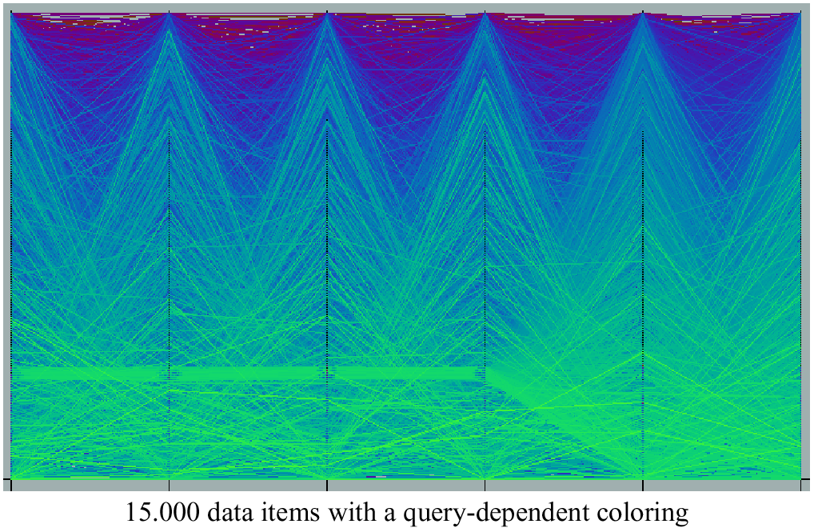
Query Dependent Coloring

Slide 24
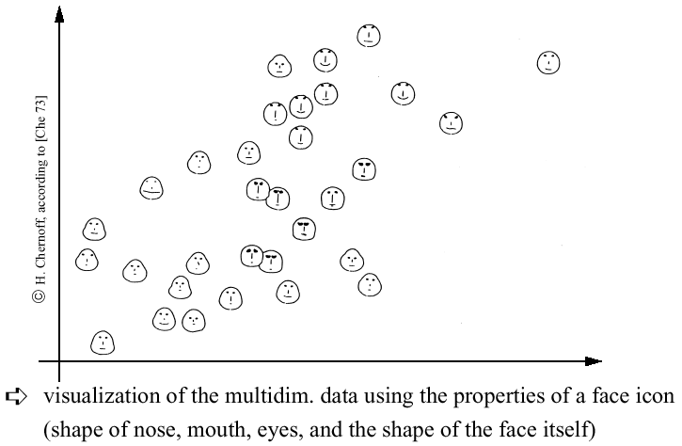
Chernoff-faces

Slide 25
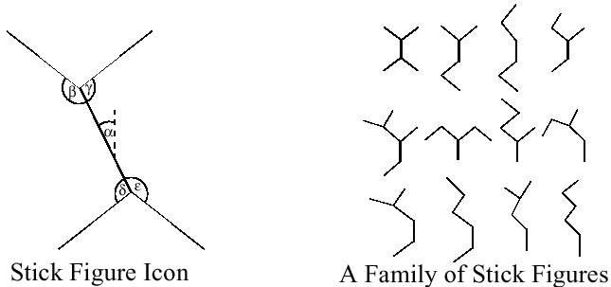
Stick Figures
Notes:
Visualization of the multidimensional data using stick figure icons
Two attributes of the data are mapped to the display axes and the remaining at-tributes are mapped to the angle and/or length of the limbs
Texture patterns in the visualization show certain data characteristics

Slide 26
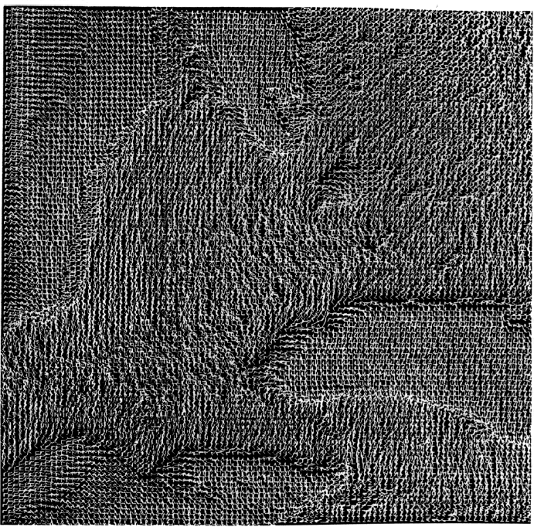
Stick Figures

Slide 27
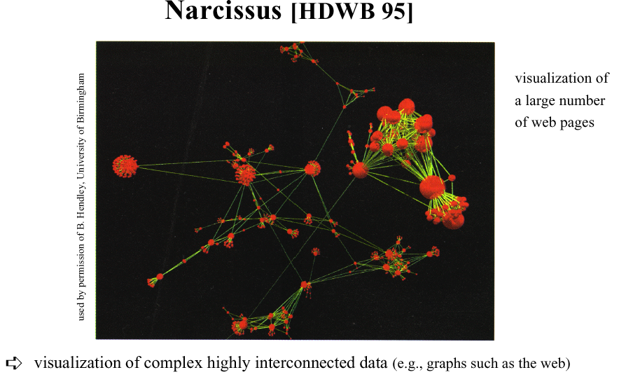
Graph-based Techniques

Slide 28
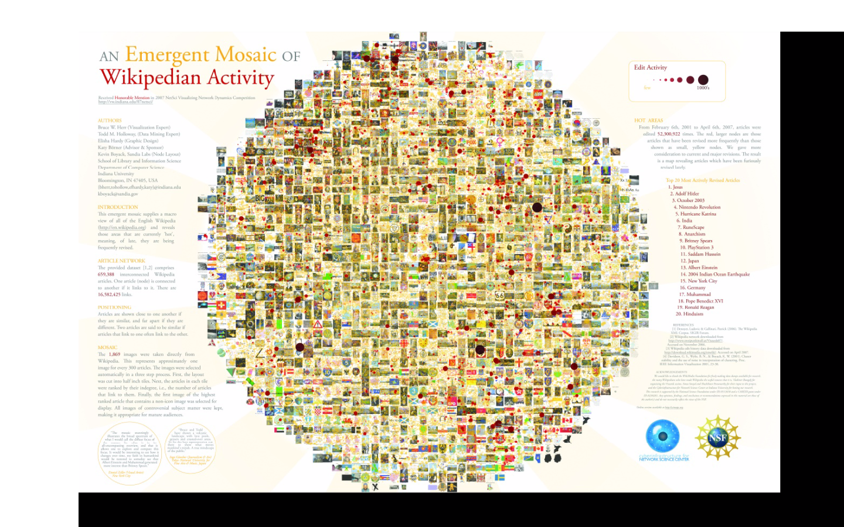
Zoomable UIs
http://gigapan.com/gigapans/4304
Notes:
he sizes of the nodes (circles, dots, whatever you want to call them), are based on a model of revision activity. So large circles indicate that an article might be controversial, or the subject of lots of vandalism, or just a topic whose content frequently changes.

Slide 29
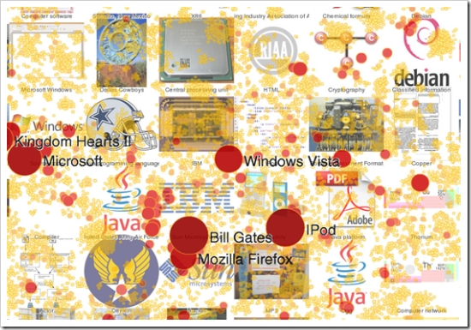
Zoomable UIs
http://gigapan.com/gigapans/4304
Notes:
he sizes of the nodes (circles, dots, whatever you want to call them), are based on a model of revision activity. So large circles indicate that an article might be controversial, or the subject of lots of vandalism, or just a topic whose content frequently changes.

Slide 30
Distortion Techniques
Basic Idea: Distortion of the image to allow a visualization of larger amounts of data
An alternative to zoomable Uis (or complement)

Slide 31
Distortion Techniques
Basic Idea: Distortion of the image to allow a visualization of larger amounts of data
Simple:
Perspective Wall [MRC91]
Bifocal Displays [SA 82]
TableLens [RC94]
Graph. Fisheye Views [Fur 86, SB94]
Hyperbolic Repr. [LR94, LRP95]
Complex:
Hyperbolic Repr. [LR94, LRP95]
3D-Hyperbolic Repr. [MB95]
Hyperbox [AC91]

Slide 32
Perspective
Notes:
Presentation of the data on a perspective wall
The data outside the focal area are perspectively reduced in size
The perspective wall is a variant of the bifocal lens
Display [SA82] which horizontally compresses the sides of the workspace by direct scaling

Slide 33
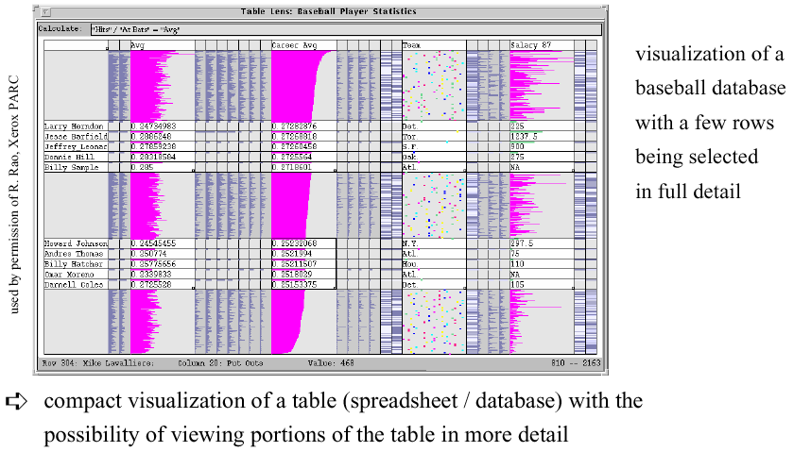
Table Lens

Slide 34
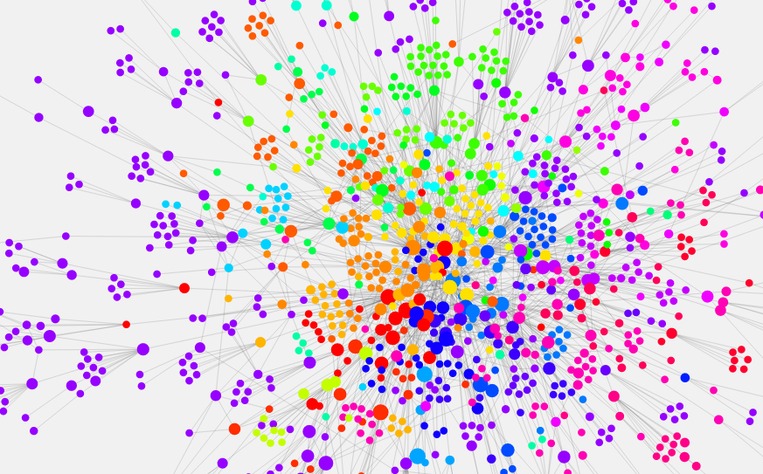
Networks of Information
http://www.designandanalytics.com/philosophers-graph/
Notes:
[a topic for byte 6]

Slide 35
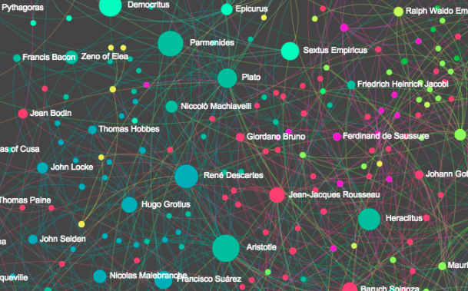
Networks of Information – with zooming
http://www.designandanalytics.com/philosophers-gephi/

Slide 36
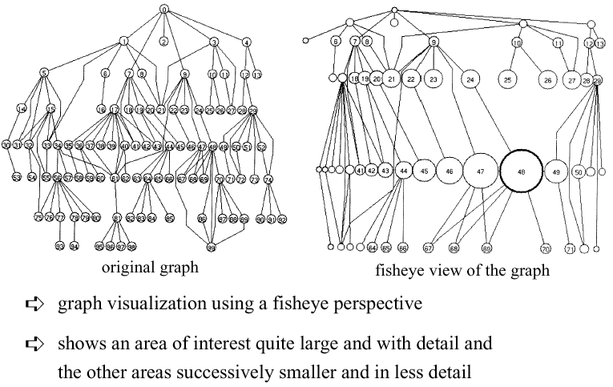
Fisheye View

Slide 37
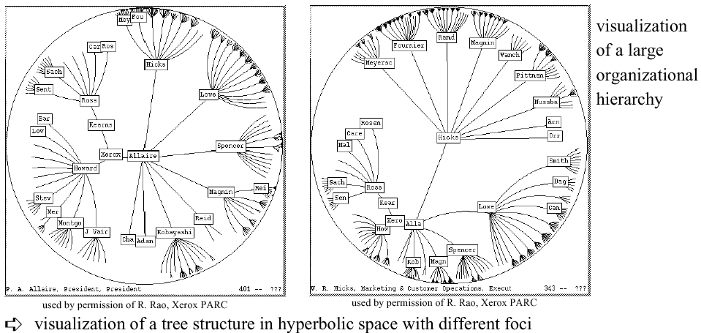
Hyperbolic Tree

Slide 38
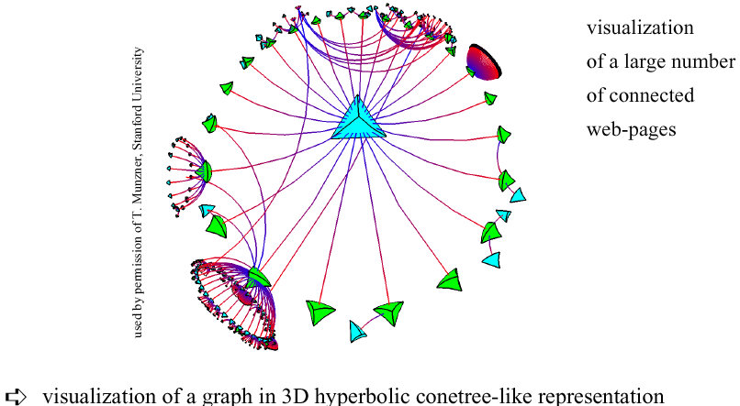
3D Hyperbolic Representation

Slide 39

Magic Lenses/Moveable Filter
interactive selection using lens-like tools which selectively filter the data in the considered areas
multiple lenses/moveable filters can be used for a multi-level filtering (allowing complex conditions)

Slide 40
TreeMap (Johnson & Shneiderman ’91)
The TreeMap Idea:
Show a hierarchy as a 2D layout
Fill up the space with rectangles representing objects
Size on screen indicates relative size of underlying objects.

Slide 41
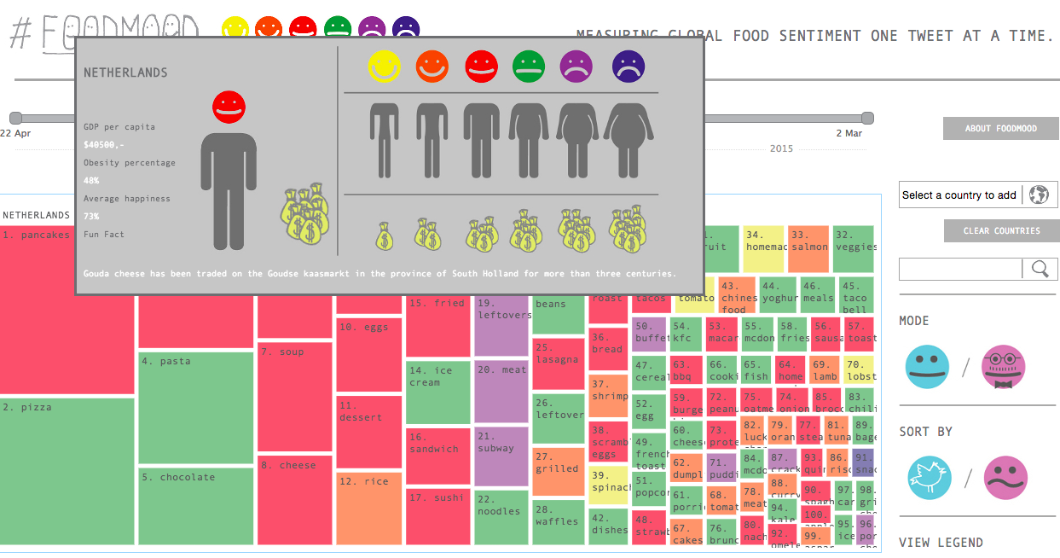
Treemap
http://foodmood.in/
Notes:
XX UPDATE – bad example, doesn’t seem to have any hierarchy!

Slide 42
Successful Application of Treemaps
Think about the use (analysis vs comunication)
Break into meaningful groups
Fix these into a useful aspect ratio
Use visual properties properly
Use color to distinguish meaningfully
Use only two colors:
Can then distinguish one thing from another
When exact numbers aren’t very important
Provide excellent interactivity
Access to the real data
Makes it into a useful tool

Slide 43
Further Reading
Big Data Issues in Climate Science
http://online.liebertpub.com/doi/full/10.1089/big.2014.0026
“Every dataset has a story, and understanding it can guide the choice of suitable analyses; some have labeled this data understanding as data empathy.”
Big Data and Health
http://online.liebertpub.com/doi/full/10.1089/big.2013.0029
“Big Data, Justice & Power… it is dangerous to think that big data, including that large-scale data can be made anonymous, are inherently objective and include tacit or explicit consent or an opt-out function.”
Notes:
‘data empathy

Slide 44
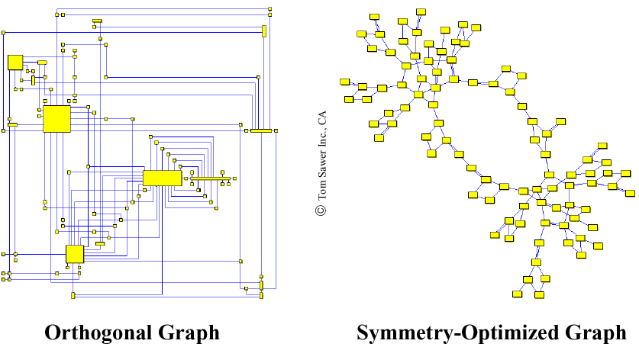
2D Graph Examples

Slide 45
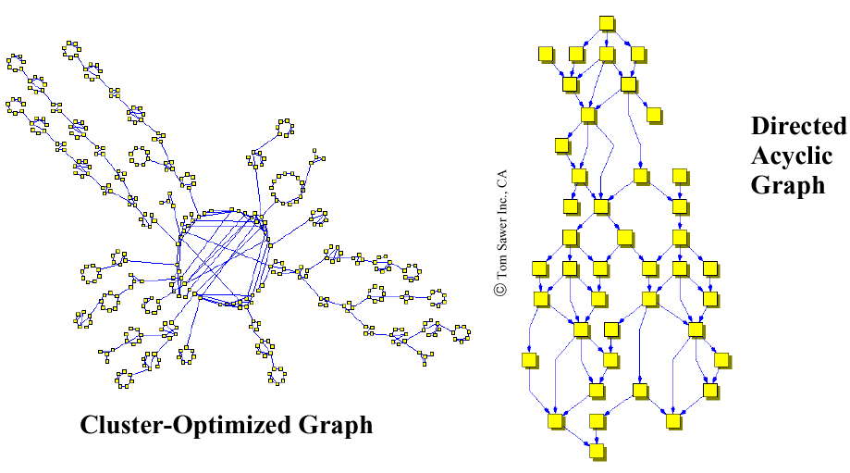
2D Graph Examples
Notes:
With Distortion
Properties of 2D-Graph Drawings
planarity (no line crossings)
orthogonality (only orthogonal lines)
grid property (coordinates of vertices are integers)
Aesthetics Properties (Optimization Goals)
minimal number of line crossings
optimal display of symmetries
optimal display of clusters
minimal number of bends in polyline graphs
uniform distribution of vertices
uniform edge lengths

Slide 46
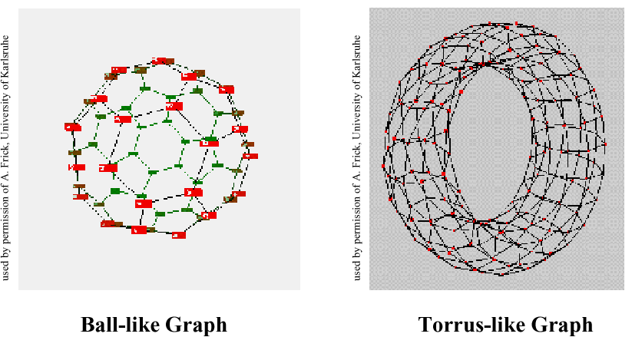
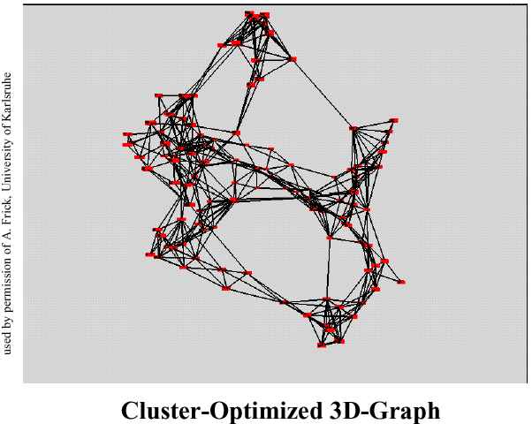
3D-Graph Drawing

Slide 47
Summary
Make use of every pixel
Use color and location to break the data up and allow the viewer to easily filter
Give a sense of things and use zooming for detail
Add a dimension such as time or height for a key variable
Allow exploration through distortion, filtering, highlighting, and linking
Exploit hierarchy and connectivity

